Slide 1
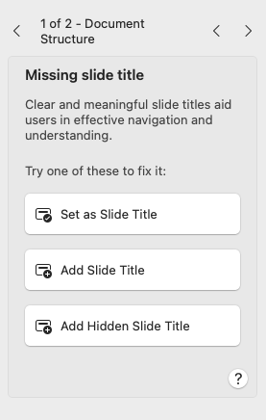
Not a title element
This slide has no title element. If exported to a tagged PDF, this slide would NOT produce an <H2> tag. The MS Accessibility Checker shows an error and provides guidance to set text as a slide title.
A11y automated checker | MS Accessibility checker
Detected | Detected

Slide 2
This text could be a hidden slide title

